Slide 1
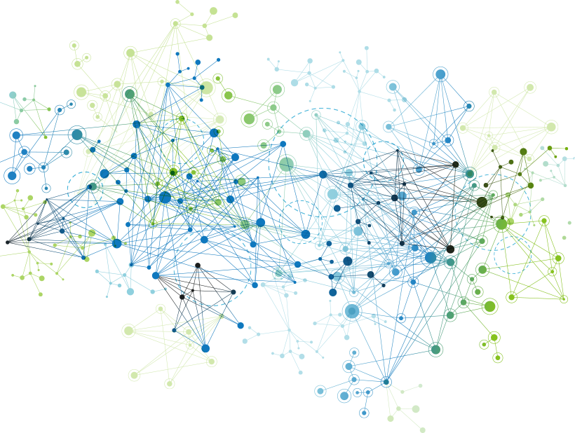
Introduction to Neural Network

Slide 2
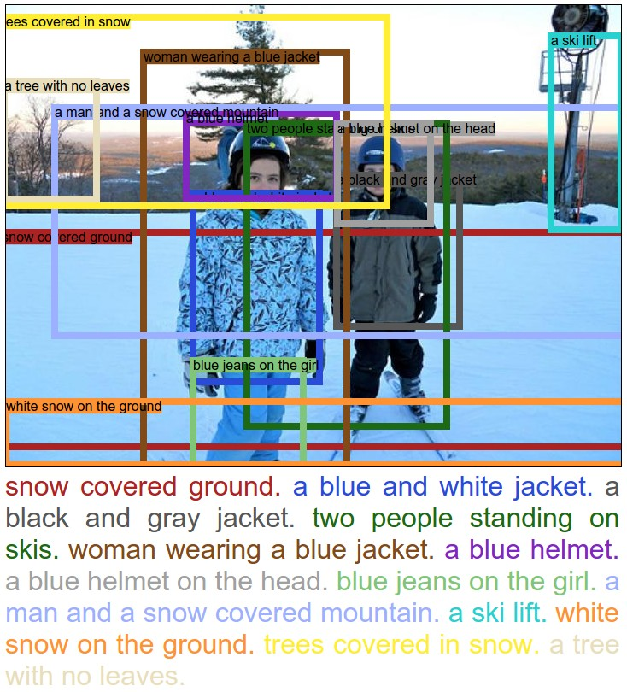

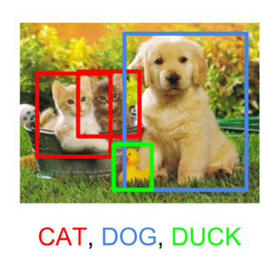
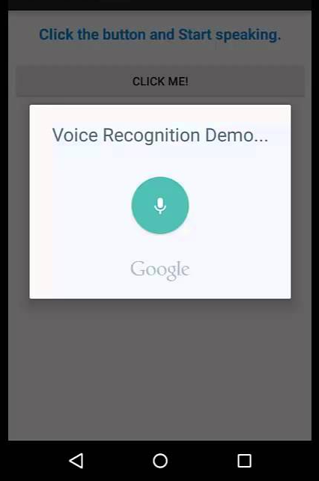
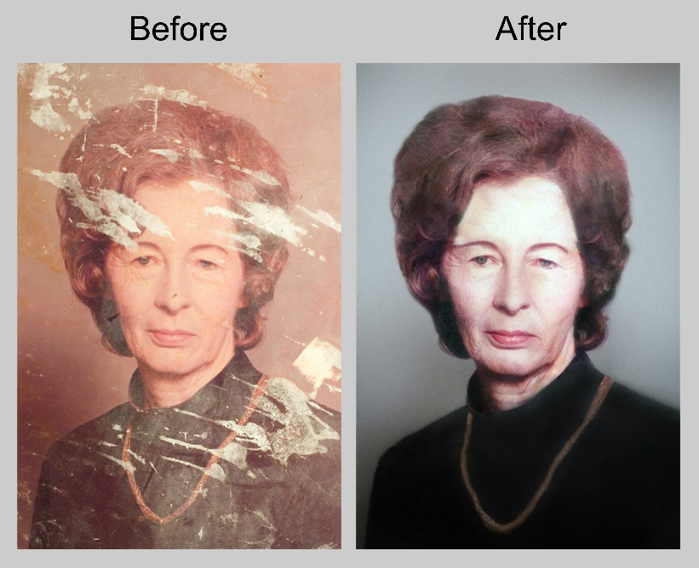


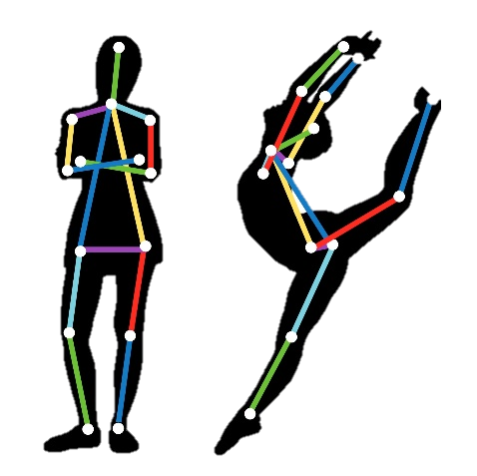
Applications

Slide 3
Neural Network

Slide 4
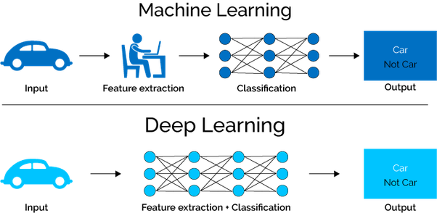
Shallow learning
Deep learning

Slide 5
Neural Network
Artificial Neural Network
(ANN)
Regression and classification
Convolutional Neural Network
(CNN)
Computer Vision
Recurrent Neural Network
(RNN)
Time series analysis

Slide 6
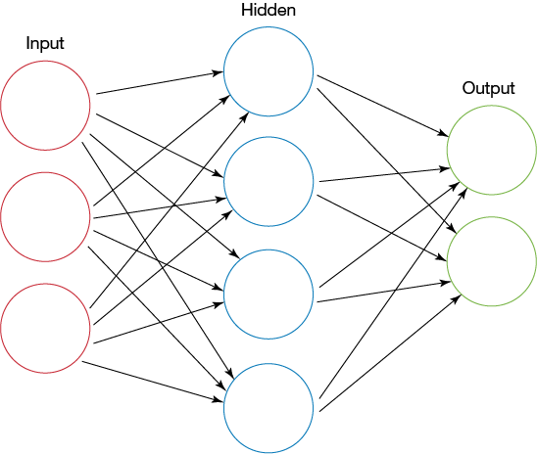
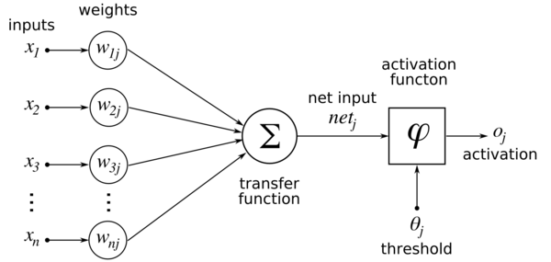
Artificial Neural Network
Single layer perceptron
Multi-layer perceptron

Slide 7
Convolutional
Neural
Network

Slide 8
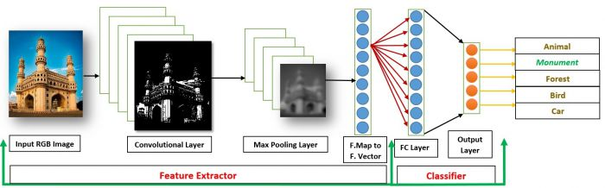
Introduction
Convolutional Neural Networks (CNNs) learns multi-level features and classifier in a joint fashion and performs much better than traditional approaches for various image classification and segmentation problems.

Slide 9

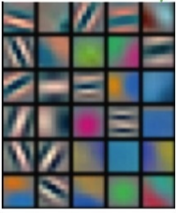
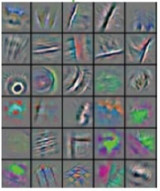
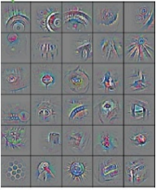
CNN – What do they learn?
Convolutional layers
Fully connected layers
Low
Level Features
Mid Level Features
High Level Features
Trainable Classifier
Output
(e.g. car, train)

Slide 10
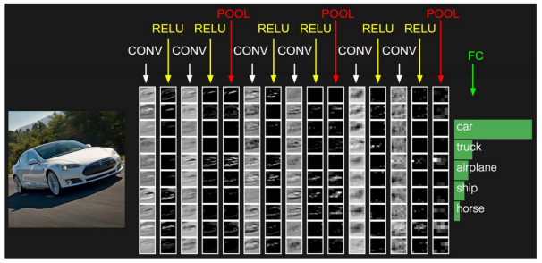
CNN - Components
There are four main components in the CNN:
Convolution
Non-Linearity
Pooling or Sub Sampling
Classification (Fully Connected Layer)

Slide 11
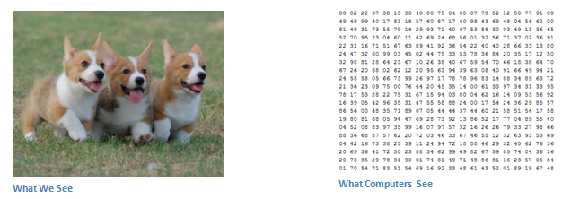
Input
An Image is a matrix of pixel values.
If we consider a gray scale image, the value of each pixel in the matrix will range from 0 to 255.
If we consider an RGB image, each pixel will have the combined values of R, G and B.

Slide 12
Convolution...
The size of the output volume is controlled by three parameters that we need to decide before the convolution step is performed:
Depth: Depth corresponds to the number of filters we use for the convolution operation.
Stride: Stride is the number of pixels by which we slide our filter matrix over the input matrix.
Zero-padding: Sometimes, it is convenient to pad the input matrix with zeros around the border, so that we can apply the filter to bordering elements of our input image matrix.
With zero-padding wide convolution
Without zero-padding narrow convolution

Slide 13
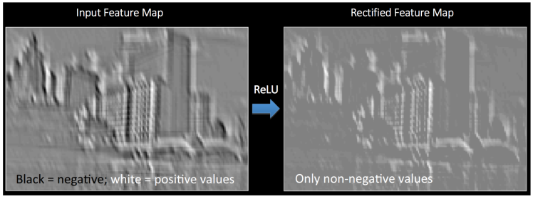
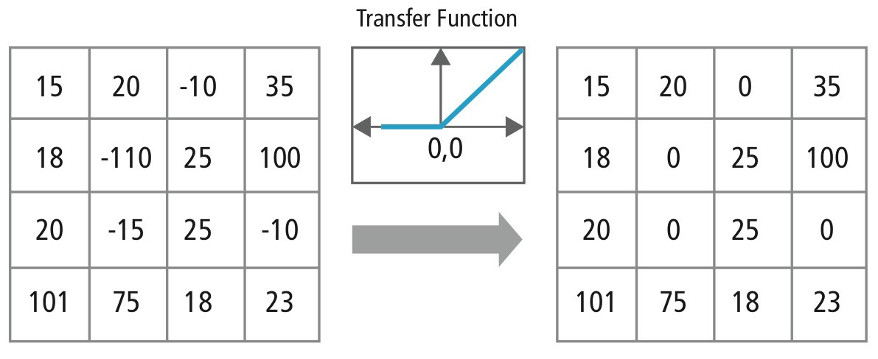
Non-Linearity (ReLU)
Replaces all negative pixel values in the feature map by zero.
The purpose of ReLU is to introduce non-linearity in CNN, since most of the real-world data would be non-linear.
Other non-linear functions such as tanh (-1,1) or sigmoid (0,1) can also be used instead of ReLU (0,input).

Slide 14
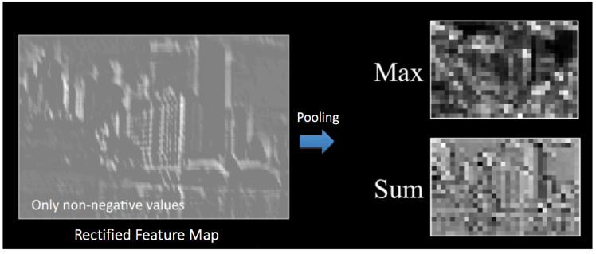
Pooling
Reduces the dimensionality of each feature map but retains the most important information. Pooling can be of different types: Max, Average, Sum etc.
2×2 region

Slide 15
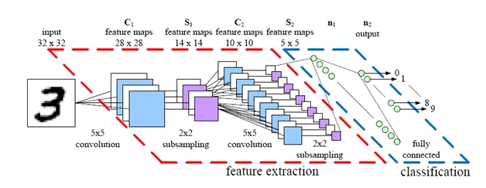
Story so far
Together these layers extract the useful features from the images.
The output from the convolutional and pooling layers represent high-level features of the input image.
High-level features

Slide 16
Overall CNN Architecture

Slide 17
Putting it all together – Training using Backpropagation
Step 1: We initialize all filters and parameters / weights with random values.
Step 2: The network takes a training image as input, goes through the forward propagation step (convolution, ReLU and pooling operations along with forward propagation in the Fully Connected layer) and finds the output probabilities for each class.
Let’s say the output probabilities for the boat image above are [0.2, 0.4, 0.1, 0.3].
Since weights are randomly assigned for the first training example, output probabilities are also random.
Step 3: Calculate the total error at the output layer (summation over all 4 classes).

Slide 18
Step 4: Use Backpropagation to calculate the gradients of the error with respect to all weights in the network and use gradient descent to update all filter values/ weights and parameter values to minimize the output error.
The weights are adjusted in proportion to their contribution to the total error.
When the same image is input again, output probabilities might now be [0.1, 0.1, 0.7, 0.1], which is closer to the target vector [0, 0, 1, 0].
This means that the network has learnt to classify this particular image correctly by adjusting its weights / filters such that the output error is reduced.
Parameters like number of filters, filter sizes, architecture of the network etc. have all been fixed before Step 1 and do not change during training process – only the values of the filter matrix and connection weights get updated.
Step 5: Repeat steps 2-4 with all images in the training set.

